Slide 1
Data mining using python lab manual

Slide 2
1.Demonstrate the following data preprocessing tasks using python libraries.
a.->Need of softwares and libraries
1.First install java and python softwares in windows and set the path.And check the versions of sw.
2.open command prompt type
Check the java version:java--version
Check the python version: python - –version
Py -m pip install numpy
Py -m pip install –upgrade pip
Py -m pip install pandas
Py -m pip install matplotlib
Above those python libraries are used for datapreprocessing

Slide 3
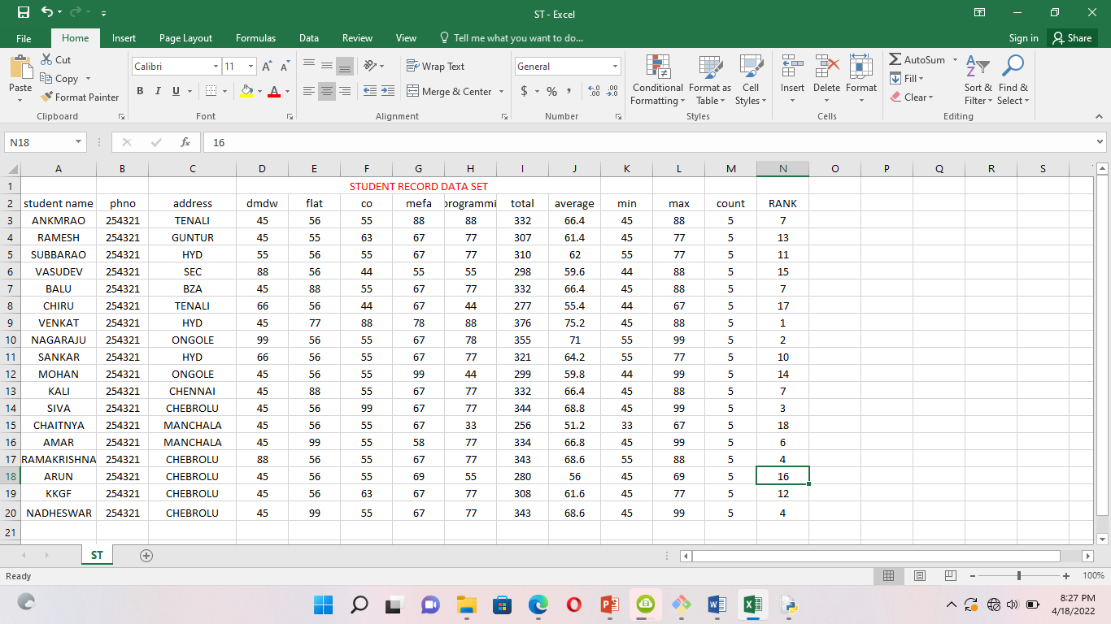
b.Creating the dataset .csv by using Ms-Excel.

Slide 4
c.AIM:. LOADING THE DATASET.csv file ?
Program: file is saved in data.py
import numpy as np
import pandas as pd
import matplotlib.pyplot as plt
df=pd.read_csv("C:/Users/Administrator/Desktop/python material/data/student record.csv")
print(df.head())

Slide 5
2.a.AIM.identifying the dependent and independent variables.?
Program:
import pandas as pd
importnumpy as np
from sklearn.impute import SimpleImputer # used for handling missing data
from sklearn.preprocessing import LabelEncoder, OneHotEncoder # used for encoding categorical data
fromsklearn.model_selection import train_test_split # used for splitting training and testing data
fromsklearn.preprocessing import StandardScaler # used for feature scaling
dataset = pd.read_csv("C:/Users/Administrator/Desktop/python material/data/Dataset.csv")
# to import the dataset into a variable
# Splitting the attributes into independent and dependent attributes
X = dataset.iloc[:, :-1].values # attributes to determine dependent variable / Class
Y = dataset.iloc[:, -1].values # dependent variable / Class
print(dataset)

Slide 6
# Single selections using iloc and DataFrame
# Rows:
data.iloc[0] # first row of data frame (AleshiaTomkiewicz) - Note a Series data type output.
data.iloc[1] # second row of data frame (Evan Zigomalas)
data.iloc[-1] # last row of data frame (MiRichan)
# Columns:
data.iloc[:,0] # first column of data frame (first_name)
data.iloc[:,1] # second column of data frame (last_name)
data.iloc[:,-1] # last column of data frame (id)
# Multiple row and column selections using iloc and DataFramedata.iloc[0:5]
# first five rows of dataframedata.iloc[:, 0:2]
# first two columns of data frame with all rowsdata.iloc[[0,3,6,24], [0,5,6]]
# 1st, 4th, 7th, 25th row + 1st 6th 7th columns.data.iloc[0:5, 5:8]
# first 5 rows and 5th, 6th, 7th columns of data frame (county -> phone1).

Slide 7
b.data visualization using python
Need library is seaborn it is install in windows by using cmd
Py -m pip install seaborn
Program:
import numpy as np
import pandas as pd
importmatplotlib.pyplot as plt
importseaborn as sns
df = sns.load_dataset('iris')
#without regression
sns.pairplot(df, kind="scatter")
plt.show()

Slide 8
3.AIM: Similarity Disimilarity Measures implementation in Python
A. Euclidean Distance Implementation in python
#!/usr/bin/env python
from math import*
def euclidean_distance(x,y):
return sqrt(sum(pow(a-b,2) for a, b in zip(x, y)))
print (euclidean_distance([0,3,4,5],[7,6,3,-1]))
B.Manhattan distance implementation in Python
#!/usr/bin/env python
from math import*
def manhatta_distance(x,y):
return sum(abs(a-b) for a,b in zip(x,y))
print (manhattan_distance([10,20,10],[10,20,20]))

Slide 9
C.Minkowsi distance implementation in python
#!/usr/bin/env python
from math import*
from decimal import Decimal
def nth_root(value, n_root):
root_value = 1/float(n_root)
return round (Decimal(value) ** Decimal(root_value),3)
def minkowski_distance(x,y,p_value):
return nth_root(sum(pow(abs(a-b),p_value) for a,b in zip(x, y)),p_value)
print manhattan_distance([10,20,10],[10,20,20])

Slide 10
D. COSINE Similarity implementation in python
#!/usr/bin/env python
from math import*
def square_rooted(x):
return round(sqrt(sum([a*a for a in x])),3)
def cosine_similarity(x,y):
numerator = sum(a*b for a,b in zip(x,y))
denominator = square_rooted(x)*square_rooted(y)
return round(numerator/float(denominator),3)
print cosine_similarity([3, 45, 7, 2], [2, 54, 13, 15])
E.Jaccard Similarity implementation in python
#!/usr/bin/env python
from math import*
def jaccard_similarity(x,y):
intersection_cardinality = len(set.intersection(*[set(x), set(y)]))
union_cardinality = len(set.union(*[set(x), set(y)]))
return intersection_cardinality/float(union_cardinality)
print (jaccard_similarity([0,1,2,5,6],[0,2,3,5,7,9]))

Slide 11
4.AIM: write a program to step by step procedure of DECISION TREE visualize Using python.
import pandas as pd
import matplotlib.pyplot as plt
#% matplotlib inline
from sklearn.datasets import load_iris
from sklearn import tree
clf=tree.DecisionTreeClassifier(random_state=0)
iris=load_iris()
clf=clf.fit(iris.data,iris.target)
plt.figure(figsize=(15,10))
tree.plot_tree(clf,filled=True)
plt.show()

Slide 12
5.Aim: write a program on linear regression using python.
Procedure:
import numpy as np
import matplotlib.pyplot as plt
import pandas as pd
from sklearn.linear_model import LinearRegression
X=np.array([1,10,20,40,50,70,80,90,120])
Y=np.array([3,20,90,110,130,170,150,200,260])
linreg=LinearRegression()
x=X.reshape(-1,1)
linreg.fit(x,Y)
Y_pred=linreg.predict(x)
plt.scatter(x,Y)
plt.plot(x,Y_pred,color="red")
plt.show()

Slide 13
6.Aim: write program easy way step by step procedure of apriori algorithm using python.
import numpy as np
import matplotlib.pyplot as plt
import pandas as pd
from apyori import apriori
#loading dataset
store_data = pd.read_csv("G:/videos/datamining/dmdw lab programs/association analysis/Day1.csv",header=None)
#having a glance at the records
nr=len(store_data)
print(nr)
print(store_data.head())
print(store_data.shape)
#converting the pandas dataframes into a list of lists

Slide 14
records = []
for i in range(0, 21):
records.append([str(store_data.values[i,j]) for j in range(0,6)])
#Building the first apriori model
association_rules = apriori(records, min_support=0.50, min_confidence=0.7, min_lift=1.2, min_length=2)
association_results = list(association_rules)
#getting the number of rules
print(len(association_results))
# Have a glance at the rule
print(association_results)

Slide 15
7.Aim: write a program for step by step procedure of k-means algorithm using python
Procedure:
#import required libraries
import numpy as np
import matplotlib.pyplot as plot
from sklearn.datasets import make_blobs
#Generate our dataset
dataset=make_blobs(n_samples=200,centers=4,n_features=2,cluster_std=1.6.random_state=50)
points=dataset[0]
#import kmeans
fromsklearn.cluster import KMeans
#create a kmeans objects
kmeans=KMeans(n_cluster=4)
#fit the Kmeans objects to the dataset
kmeans.fit(points)
plt.scatter(dataset[0][:,0],dataset[0][:,1])
#create cluster
clusters=kmeans.cluster_centers_
#print out the clusters
print(clusters)

Slide 16
y_km=kmeans.fit_predict(points)
points
plt.scatter(points[y_km==0,0],points[y_km==0,1],s=50,color='red')
plt.scatter(points[y_km==1,0],points[y_km==1,1],s=50,color='green')
plt.scatter(points[y_km==2,0],points[y_km==2,1],s=50,color='yellow')
plt.scatter(points[y_km==3,0],points[y_km==3,1],s=50,color='cyan')
plt.scatter(clusters[0][0],clusters[0][1],marker='*',s=200,color='black')
plt.scatter(clusters[1][0],clusters[1][1],marker='*',s=200,color='black')
plt.scatter(clusters[2][0],clusters[2][1],marker='*',s=200,color='black')
plt.scatter(clusters[3][0],clusters[3][1],marker='*',s=200,color='black')
plt.show()

Slide 17
8.Aim: write a program for step by step procedure of hierarchical clustering algorithm using python.?
# importing the libraries
import numpy as np
import matplotlib.pyplot as plt
import pandas as pd
# Importing the dataset
dataset = pd.read_csv("G:/videos/datamining/dmdw lab programs/Wholesale customers data.csv")
X = dataset.iloc[:, [3, 4]].values
from sklearn.preprocessing import normalize
data_scaled = normalize(dataset)
data_scaled = pd.DataFrame(data_scaled, columns=dataset.columns)
data_scaled.head()
X=data_scaled
X.head()

Slide 18
# Using the dendrogram to find the optimal number of clusters
import scipy.cluster.hierarchy as sch
dendrogram = sch.dendrogram(sch.linkage(X, method = 'ward'))
plt.title('Dendrogram')
plt.xlabel('Customers')
plt.ylabel('Euclidean distances')
plt.show()
# Training the Hierarchical Clustering model on the dataset
from sklearn.cluster import AgglomerativeClustering
hc = AgglomerativeClustering(n_clusters = 2, affinity = 'euclidean', linkage = 'ward')
y_hc = hc.fit_predict(X)
print(y_hc)
# Visualising the clusters
plt.figure(figsize=(10, 7))
plt.scatter(X['Milk'], X['Grocery'], c=hc.labels_)
plt.show()

Slide 19
9.Aim: write program for a step by step procedure of DBScan algorithm using python.?
Procedure:
import numpy as np
from sklearn.datasets import make_blobs
from matplotlib import pyplot as plt
from pandas import DataFrame
X, _ = make_blobs(n_samples = 500, centers = 3, n_features = 2, random_state = 20)
df = DataFrame(dict(x=X[:,0], y=X[:,1]))
fig, ax = plt.subplots(figsize=(8,8))
df.plot(ax=ax, kind='scatter', x='x', y='y')
plt.xlabel('x_1')
plt.ylabel('x_2')
plt.show()

Slide 20
#We are just getting the labels of the clusters in the next step.
from sklearn.cluster import DBSCAN
clustering = DBSCAN(eps = 1, min_samples = 5).fit(X)
cluster = clustering.labels_
#To see how many clusters has it found on the dataset
len(set(cluster))
# You can see we just visualize our clusters by this simple piece of code .
def show_clusters(X, cluster):
df = DataFrame(dict(x=X[:,0], y=X[:,1], label=cluster))
colors = {-1: 'red', 0: 'blue', 1:'orange', 2:'green', 3:'yellow'}
fig, ax = plt.subplots(figsize=(8,8))
grouped = df.groupby('label')
for key, group in grouped:
group.plot(ax=ax, kind='scatter', x='x', y='y', label=key, color=colors[key])
plt.xlabel('x_1')
plt.ylabel('x_2')
plt.show()
show_clusters(X, cluster)

Slide 21
10.Aim:write a program for step by step procedure of apply navie bayes classifier on any dataset using python.?
Procedure:
import numpy as np
import pandas as pd
import matplotlib.pyplot as plt
import seaborn as sns
from sklearn.model_selection import train_test_split
from sklearn.naive_bayes import GaussianNB
#% matplotlib inline
from sklearn.datasets import load_iris
##data=load_iris()
data=pd.read_csv("G:/videos/datamining/dmdw lab programs/Iris.csv")
print(data)

Slide 22
x=data.iloc[:,:-1].values
y=data.iloc[:,-1].values
print(x,y)
x_train,x_test,y_train,y_test=train_test_split(x,y,test_size=0.4,random_state=50)
print(x_train,y_train)
(y_train==0).sum()
(y_train==1).sum()
(y_train==2).sum()
gnb=GaussianNB()
gnb.fit(x_train,y_train)
y_pred=gnb.predict(x_test)
print("total number of instances:(x_test.shape(0)) Incorrect Guesses:(y_test!=y_pred).sum())")

